Slide 1
Analysis of the HTTPS Certificate Ecosystem
Zakir Durumeric, James Kasten,
Michael Bailey, J. Alex Halderman
University of Michigan
Notes:
This afternoon I would like to speak about the certificate authority ecosystem – the PKI that supports HTTPS.
This was joint work done with James Kasten, Michael Bailey, and Alex Halderman out of the University of Michigan

Slide 2
HTTPS and TLS
How does HTTPS and the CA ecosystem fit into our daily lives?
Nearly all secure web communication relies on HTTPS
- online banking, e-mail, e-commerce transactions, etc.
HTTPS provides confidentiality, integrity, and authentication
HTTPS is dependent on a supporting PKI – thousands of certificate authorities we rely on to vouch for sites’ identities
The supporting PKI is opaque – we blindly rely on these CAs
There has been much previous work including including the EFF’s SSL Observatory, Holz et al. at IMC, and Akhawe et al. at WWW
Notes:
We use on HTTPS everyday for secure web communication – everything from online banking to the web access of our email
We’re really relying HTTP to provide three aspects of secure communication: confidentiality, integrity, and authentication.
However, in order for HTTPS to provide authentication, we are dependent on a supporting public-key-infrastructure or PKI
Thousands of organizations that vouch for sites’ identities
And this security-critical ecosystem is fairly opaque – in many ways we depend on it blindly
Given how critical HTTPS is to our daily lives, there has been much previous work in the space including
The SSL Observatory in 2010, SSL Landscape in 2011, and recent work out of Berkeley at WWW
Today, I want to specifically talk about the certificate authorities that support the ecosystem

Slide 3
Talk Outline
HTTPS Background
Data Collection Methodology
Identifying Trusted Authorities
Worrisome Trends and Observations
How can we make the HTTPS ecosystem more secure?
Notes:
Today, I first want to briefly discuss how HTTPS uses certificate authorities provide authentication, how we ended up in the situation where we’re blinding relying on this ecosystem
How we went about collecting data about the ecosystem – how did we discover
Identify who the current CAs are, how they came to be, and how they make up this ecosystem. “Who are the certificate authorities”
Discuss several of the most worrisome trends we’ve noticed in the ecosystem over the past year “What are CAs doing that puts the entire ecosystem at risk?”
Lastly, I want to touch on how some ways that we can move forward as a community to make the ecosystem more secure

Slide 4
Certificate Authorities
How do certificates provide authentication?
Web browsers trust certificate authorities to investigate and vouch for the identities of trusted websites
CAs vouch for a website’s identity by signing digital certificates with a browser trusted certificate and key
Web browsers store a list of these trusted authorities’ certificates known as roots
Web Brower
CA Certificate
Website
Website
Notes:
In the HTTPS ecosystem, we trust a set of organizations known as “certificate authorities” to investigate and digitally vouch for the identity of a website
This is how we know that when we go to google.com in our browser that we are establishing a secure connection with Google and not someone who may be MITMing our connection
The way this is done is that a set of trusted digital certificates known as “root authorities” belonging to these organizations are shipped with web browsers and OSes
Organizations use these CA certificates to sign a certificate for a website and if we trust that if a CA signed a certificate, then it is a valid website.

Slide 5
Intermediate Authorities
How do intermediate authorities fit into the picture?
Root authorities delegate the ability to sign certificates to intermediate authorities
Web Browser
Root Certificate
Root Certificate
Intermediate
Intermediate
Website
Website
Notes:
However, CAs can also sign what we call an “intermediate certificate” – essentially creating a sub CA that wields all of the same signing authority as the original
And this helpful in many cases because this allows CAs to keep their master key offline in case of compromise.

Slide 6
Intermediate Authorities
How do intermediate authorities fit into the picture?
Root authorities delegate the ability to sign certificates to intermediate authorities
In all but a handful of cases, intermediates can sign for certificates for any domain
Web Browser
Root Certificate
Root Certificate
US Gov’t
Google
google.com
google.com
Notes:
However it also allows CAs to delegate their signing power to other third party organizations
And in all but a few cases, these intermediate authorities wield the same power as the original root certificate – they can sign for any website
This means that while Google’s CA can sign for google.com, so can every other organization with a CA certificate

Slide 7
Intermediate Authorities
How do intermediate authorities fit into the picture?
Root authorities delegate the ability to sign certificates to intermediate authorities
In all but a handful of cases, intermediates can sign for certificates for any domain
Non-roots aren’t publicly known until they are found in the wild
Web Browser
✓
Root Certificate
Root Certificate
?
US Gov’t
Google
?
google.com
google.com
Notes:
We know who the roots are at any given time because they are included with a web browser.
However, intermediate certificates are not included. Instead a “chain” of certificates is included during the HTTPS handshake
If there’s a valid chain up to a trusted root authority, we will trust the certificate
This ultimately means that we don’t know the organizations with power to a sign a certificate at any given nor do we know what certificates they have signed
UNTIL we see them in the wild.

Slide 8
Intermediate Authorities
How do intermediate authorities fit into the picture?
Web Browser
✓
Hundreds of roots
?
Thousands of intermediates
?
Millions of leaf certificates
Notes:
And while this seems non-optimal, we could see how this might work out in a small ecosystem if everyone acted responsibly
However, instead, we have hundreds of root certificates in each browser, thousands of intermediate certificates, and millions of leaf certificates in play

Slide 9
Talk Outline
HTTPS Background
Data Collection Methodology
Identifying Trusted Authorities
Worrisome Trends and Observations
How can we make the HTTPS ecosystem more secure?
Notes:
We have this large, very distributed ecosystem, how do we go about measuring it? Especially if we want to know who all the edge nodes – those we wouldn’t see on a daily basis are?

Slide 10
Dataset and Methodology
How do we measure the certificate authority ecosystem?
We performed 110 scans of the IPv4 address space over an 18 month period using ZMap, OpenSSL, and libevent
Completed 1.8 billion TLS handshakes and collected certificates
We collected: - 42 million unique certificates - 6.9 million browser trusted
from 109 million hosts
Dataset available at https://scans.io and code at https://zmap.io
Notes:
There have been many differnet methodologies previously proposed for studying the ecosystem – ranging from passive monitoring to scanning the alexa 1 million
We decide to scan exhaustively
If we only scanned the alexa 1 million, we would have seen only 30% of the certificate authorities that we found in our study.
We cannot guarantee that we will see every certificate, but by scanning exhaustively, we find far more than other types

Slide 11
Responsible Data Collection
How do we reduce the impact of active scanning?
Reducing Scan Impact
Scan in random order and at a reduced scan rate
Signal benign nature over HTTP, DNS, and WHOIS
Honor all requests to be excluded from future scans
Excluded Networks
Correspondence with 145 individuals and organizations
Excluded 91 networks (.11% of the address space)
2 requests from ISPs account for 50% of addresses
Notes:
While scanning is a powerful research methodology, we must also consider the ethical implications of performing such surveys

Slide 12
Talk Outline
HTTPS Background
Data Collection Methodology
Identifying Trusted Authorities
Worrisome Trends and Observations
How can we make the HTTPS ecosystem more secure?
Notes:
I want to broadly describe what this ecosystem looks like
Who are the players? The root authorities? The

Slide 13
Identifying Trusted Authorities
Who do we trust to sign a certificate for any website?
Identified 1,832 CA certificates belonging to 683 organizations
80% of the organizations were not commercial CAs
Organizations included religious institutions, libraries, cities, corporations, and non-profits
CA certificates were owned by organizations in 57 countries
CAs by Organization Type
Academic Institutions | 40%
Commercial Authorities | 20%
Governments | 12%
Corporations | 12%
Other Types | 16%
CAs by Owning Country
United States | 30%
Germany | 21%
France | 4%
Japan | 3%
Other Countries | 42%
Notes:
5 intermediate authorities lacked any identifying information that would allow us to attribute them to an organization given just the CA certificate

Slide 14
The Path to Power
How are organizations obtaining CA certificates?
311 (45%) of the organizations were provided certificates by German National Research and Education Network (DFN)
A large number of root CAs have provided CA certificates to unrelated third-party organizations and governments
Largest were GTE CyberTrust Solutions (Verizon) and Comodo
- Provided unrestricted CA certificates to 62 organizations
Financial institutions (e.g. Visa) and some countries used CA certificates included in each brower root store

Slide 15
Distribution of Trust
Who do we trust on a day-to-day basis?
Large companies have acquired smaller CAs
75% are signed by Comodo, Symantec, and GoDaddy
90% are descendants of 4 roots
90% are signed by 40 intermediates
26% are signed by a single intermediate certificate

Slide 16
Talk Outline
HTTPS Background
Data Collection Methodology
Identifying Trusted Authorities
Worrisome Trends and Observations
How can we make the HTTPS ecosystem more secure?
Notes:
I want to talk about some of the most worrisome observations we made over the past year. This is just the tip of the iceberg of many phenomenon we describe in the paper, but I hope it starts to paint a picture of how this ecosystem is actually functioning.

Slide 17
Misaligned Objectives
CAs are providing services that harm the HTTPS ecosystem
Only 7 of the CA certificates we found had a name constraints
- All other organizations can sign for any domain
Only 40% of CA certificates had a length constraint
- All other organizations can create new CA certificates
Almost 5% of certificates are trusted for a local domain
- e.g. mail, exchange, and intranet
- provide no actual protection against attackers
Notes:
CAs have financial incentive to provide services that put the ecosystem at risk and are providing these services

Slide 18
Community Shortsightedness
We are not considering the long-term consequences today
CA certificates are being issued for 40+ years in the future
49% of certificates have a 1024-bit key in their trust chain
In 2012, 1.4 million signed new certificates were signed using a 1024-bit root authority
15 organizations provide no avenues for revocation
70% of trusted CA using a 1024-bit key certificates expire after 2016

Slide 19
Client Deployment Difficulties
It remains difficult for end-users to correctly deploy HTTPS
13% of hosts serving once trusted certificates are misconfigured
20% of hosts remove expired certificates after expiration or revocation
47 of the signing certificates were not for web traffic due to end users using code signing keys, etc.
CAs by Owning Country
Expired | 6%
Not Yet Valid | .02%
Revoked | .3%
Incorrect Intermediates | 7%
Unnecessary Root | 42%
Optimal Configuration | 45%

Slide 20
Impact of the Lack of Oversight
What is the real world impact of these observations?
We are making errors on a day-to-day basis
There’s has been an impact to ignoring our community’s guidelines such as least privilege and defense in depth
Case 1: A mis-issued CA certificate issued by Turktrust to a transit authority that was revoked after signing for *.google.com
Case 2: South Korea misissued 1,400 CA certificates that were prevented from causing harm by a root length constraint

Slide 21
Talk Outline
HTTPS Background
Data Collection Methodology
Identifying Trusted Authorities
Worrisome Trends and Observations
How can we make the HTTPS ecosystem more secure?

Slide 22
Moving Forward
How do we make the HTTPS Ecosystem more secure?
A lack of oversight has led to an unmaintainable ecosystem
- We need to consider ideas such as Certificate Transparency
Groups such as the CA/B Forum are on the right track, but are toothless and even their members are ignoring their policies
We need web browsers to coordinate and demand change
A lot of recent work on bugs in TLS implementations, but also important to consider how we help users to move to HTTTPS

Slide 23
Conclusion
Analyzed HTTPS Ecosystem by performing regular comprehensive scans of the IPv4 address space
Identified CA certificates, the organizations that control a CA certificate, and how they gained these rights
Explored several of the most worrisome trends that we observed over the past year of scanning
Discussed potential avenues for the security community to improve the HTTPS ecosystem moving forward

Slide 24
Questions?
Zakir Durumeric, James Kasten,
Michael Bailey, J. Alex Halderman
University of Michigan
https://httpsecosystem.org

Slide 25
The Matter of Heartbleed
Zakir Durumeric, Frank Li, James Kasten, Johanna Amann, Jethro Beekman, Mathias Payer, Nicolas Weaver, David Adrian, Vern Paxson, Michael Bailey, J. Alex Halderman
University of Michigan University of California—Berkeley
University of Illinois—Urbana Champaign International Computer Science Institute
Purdue University
Notes:
Good afternoon. Today I’m going to be talking about the Heartbleed Vulnerability from April of this year, including who was affected, how operators reacted, the attacks that took place, and the Internet-scale vulnerability notification we undertook.

Slide 26

Heartbleed Vulnerability
In April 2014, OpenSSL disclosed a catastrophic bug in their implementation of the TLS Heartbeat Extension
Vulnerability allowed attackers to dump private cryptographic keys, logins, and other private user data
Potentially effected any service that used OpenSSL for TLS—including web, mail, messaging and database servers
An estimated 24-55% of HTTPS websites were initially vulnerable
Notes:
In April 2014, OpenSSL disclosed a catastrophic vulnerability in their implementation of the TLS Heartbeat Extension.
The vulnerability affected any service that utilized OpenSSL to facilitate TLS connections and allowed attackers to remotely dump private data from memory including cryptographic keys, login credentials, and data passed over the TLS channel.
Ultimately, this ended up affecting a large number of online services. In the case of web servers, we estimate that between 24-55% of all HTTPS sites were initially vulnerable to the bug.

Slide 27

TLS Heartbeat Extension
01
length
<<length>> bytes
random padding
Notes:
The Heartbeat Extension allows TLS endpoints to detect whether their peer is still present. The extension was developed in 2011 and released in 2012 as part of OpenSSL 1.0.1.
Most of us had never heard of it prior to the Heartbleed vulnerability—for the most part, we never use the extension. This is because it is primarily used by Datagram TLS. In most cases, TLS relies on TCP to provide session management. However, the extension was enabled by default in OpenSSL and most systems were therefore vulnerable.
Any time during a session, either peer can send a HeartbeatRequest, in which it includes random data that is then echoed back by its peer.

Slide 28
TLS Heartbeat Extension
01
length
<<length>> bytes
random padding
random padding
<<length>> bytes
02
length
Notes:
Upon receiving the request, the TLS peer will then send back a HeartbeatResponse indicating its presence.

Slide 29
Heartbleed Vulnerability
01
length
data
padding
5HRG4y9N2vvbXNUwv0Jgi5eRv8ilIFhm4qpdc8t9xTTBZdata&username=zakir&password=123lnI1c9rX7ZayyY2N0H72MngCOUuWIogpPuRabENAkXlkH8t3Os05q8v
data&username=zakir&password=123
Heartbleed Vulnerability: server trusts user provided length field and echoes back memory contents following request data
Notes:
The bug occurred because OpenSSL trusted the user provided length field and will respond with any additional information in memory after the user-provided data.
The bug is simple and the solution easy—check the amount of data sent in the message and see if it matches the length field. However, while simple, it has the potential to leak data ranging from private keys to user credentials.

Slide 30




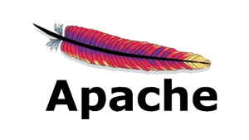






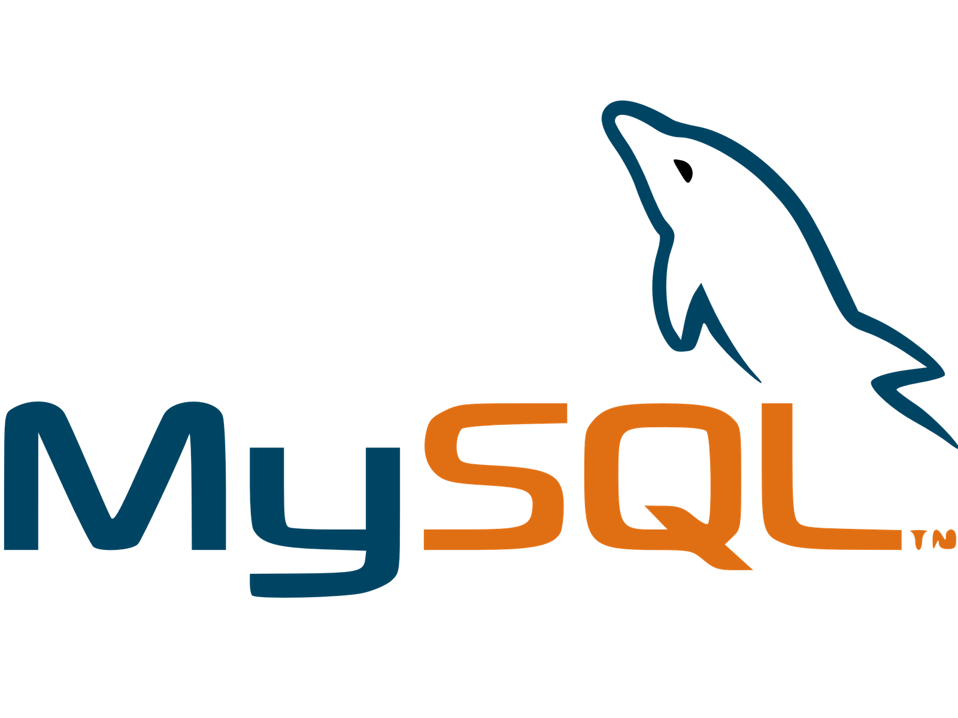








Notes:
The press primarily focused on vulnerable websites, but many, many different services utilize TLS for transport security. Services ranging from Tor and Bitcoin clients to database servers and wireless protocols were affected by the bug.

Slide 31
Database Servers
Messaging Servers
Crypto Currencies
Web Servers
POP3/IMAP Servers
SMTP Servers
Notes:
Today, I’m primarily going to talk about Heartbleed’s impact on web servers, but there are additional details on other protocols in the paper.

Slide 32

Tracking the Vulnerability
RFC 6520 Compliant
Data Collection
Began scanning 48 hours after public disclosure
Scanned Alexa Top 1 Million and 1% samples of IPv4 every 8 hours
Scanning for Heartbleed
Modified ZMap to scan for vulnerable versions of OpenSSL
Instead of exploiting the vulnerability, we checked for non-compliant behavior of vulnerable OpenSSL version
01
0 bytes
(no data or padding)
Vulnerable OpenSSL
01
0 bytes
(no data or padding)
0 bytes
(no data)
padding
01
Notes:
In order to track who was vulnerable to Heartbleed, we modified the ZMap scanner to test for the Heartbleed vulnerability. We began scanning approximately 48 hours post disclosure and completed scans of the Alexa Top 1 Million and 1% samples of the IPv4 address space every 8 hours.
However, instead of exploiting the vulnerability itself, we instead tested for a particular behavior associated with the vulnerable version of OpenSSL. The original specification for Heartbeat states that a server should drop empty requests — those which have a zero length, and contain no data or padding. And this is what both the patched version of OpenSSL and other libraries in fact do.
However, the vulnerable version of OpenSSL responds with random padding.

Slide 33
Tracking the Vulnerability
RFC 6520 Compliant
Data Collection
Began scanning 48 hours after public disclosure
Scanned Alexa Top 1 Million and 1% samples of IPv4 every 8 hours
Scanning for Heartbleed
Modified ZMap to scan for vulnerable OpenSSL versions
Instead of exploiting the vulnerability, we checked for non-compliant behavior of vulnerable OpenSSL version
We did not exploit Heartbleed Vulnerability—no private memory is ever sent back by the server
01
0 bytes
(no data or padding)
Vulnerable OpenSSL
01
0 bytes
(no data or padding)
0 bytes
(no data)
padding
01
Notes:
This is means that servers will respond back with randomly generated padding, but no leaked server memory, which allows us to check for the vulnerability.

Slide 34
Top 100 Websites
By aggregating press releases and others’ scans, we found evidence that at least 44 of the Top 100 sites were initially vulnerable
A small handful of sites remained vulnerable at 24 hours—including Yahoo, Imgur, Stack Overflow, Flickr, Sogou, Ok Cupid, and Duck Duck Go
The Top 500 sites were patched within 48 hours—when we began our regular scans
Notes:
By the time we began scanning 48 hours post disclosure, the Top 100 most popular websites were all patched. However, these sites are incredibly important and likely what attackers were first targeting.
Several news organizations pressured sites for information and many sites either published press releases or provided quotes to news organizations about how they were affected. Similarly, several other researchers performed
smaller more targeted scans of these top sites.
By aggregating these press releases and others’ scans, we know that at least 44 of the top 100 sites were affected. Most patched very quickly, but a small handful of sites, including Yahoo, Imgur, and OKCupid remained vulnerable more than 24 hours after disclosures.
The top 500 were patched when we started scanning.

Slide 35

Our First Scan — Disclosure + 2 Days
Unclear who was initially vulnerable beyond the Top 100—little attention was paid to the extension prior to public disclosure
45% of all sites
support HTTPS
Heartbeat Support
No Heartbeat
No HTTPS Support
60% of HTTPS sites
support Heartbeat
Notes:
While we can gather some information about the Top 100 sites from press releases, they likely operate very differently from other smaller websites. And while little attention was paid to the extension, we can estimate how many popular sites were affected.
In our first scan of the Alexa Top 1 Million, we found that 45% of sites supported HTTPS, of which 60% supported the Heartbeat Extension.

Slide 36
Our First Scan — Disclosure + 2 Days
60% of HTTPS Sites
Heartbeat Support
No HB Support
No HTTPS Support
55% of HTTPS sites were affected
Vulnerable
Non-Vulnerable Affected Software
Non-Vuln
Software
18% Vulnerable
9% used Non-Affected Software
Notes:
However, only 91% of the sites that supported the Heartbeat Extension used software that uses OpenSSL and was affected by Heartbleed. If all of those servers had been initially vulnerable, then 55% of HTTPS sites would have been affected.

Slide 37
Estimating Initial Impact
No Scans in the first 48 hours — how do we estimate initial impact?
Upper Bound
If all the servers that support Heartbeat and used affected software were initially vulnerable—55% of HTTPS sites were affected
Lower Bound
TLS 1.1 and 1.2 were introduced along with Heartbeat in OpenSSL 1.0.1
32.6% of sites supported TLS 1.1 or 1.2, of which 73% use affected software
We estimate that 24-55% of Alexa sites were initially vulnerable
Notes:
Codenomicon estimated that 66% of sites were vulnerable based on sites that used nginx or Apache. This was likely an overestimate, but not necessarily by much.
From the last slide, if we assume that everyone using affected software was vulnerable was affected, at most 55% would have been vulnerable
And your immediate reaction might be that this is likely not an upper bound because users might have just disabled Heartbeat support.
However, it was not possible to disable support through a configuration change—instead users would have been required to recompile OpenSSL from scratch.
Would have been much easier to just disable support.
However this is an upper bound. Older sites may have been using older versions of OpenSSL that was not vulnerable.
We analyzed historical data from Trustworthy Internet Movement’s SSL Pulse’s monthly scans of Alexa sites

Slide 38
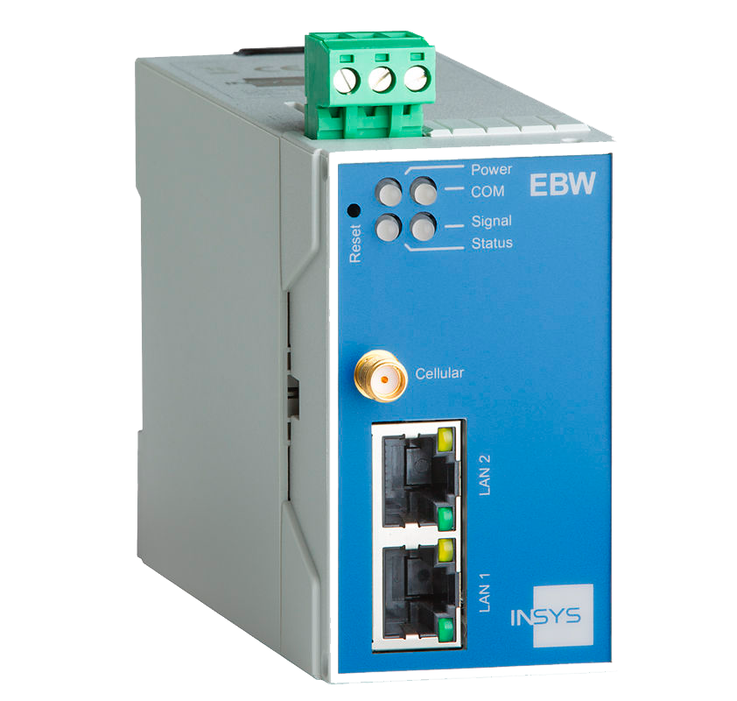






What about the rest of the Internet?
11% of IPv4 HTTPS hosts supported Heartbeat
6% of HTTPS hosts were vulnerable
We investigated clusters of similar certificates and found 74 common vulnerable devices
Notes:
We also performed scans of the full IPv4 address space, which found that not only were websites affected, but a large number of embedded devices.
In whole, a smaller number of hosts were affected. Only 11% of IPv4 hosts supported Heartbeat (versus 60% of popular sites) and only 6% of hosts were vulnerable.
What we did find was that a large number of the vulnerable hosts were either embedded devices or software packages. These ranged from SCADA devices and security cameras to web hosting management software and in one case, a Pizza Point of Sale service.

Slide 39
Patching Behavior
Notes:
So know that a large percentage of both popular websites and devices were affected by the bug. But how did network operators respond?
Well in the case of popular websites, sites did fairly well. By the time of our first scan, less than 12% of sites remained vulnerable. However, 3% of sites remained vulnerable two months after disclosure, where it remains rather stagnant.
The scans of the full IPv4 address space are less optimistic.

Slide 40
Patching Behavior
Notes:
The fist thing you note is a large, almost 50% drop in vulnerable hosts. This occurred when several large hosting providers patched all of the hosts in their AS during the same time period. And we note that almost 60% of the vulnerable hosts are in only 10 ASes.
However, unfortunately, besides that one drop, there’s only been a small amount of patching and close to 2% of the IPv4 hosts remained vulnerable after two months.

Slide 41
How fast is fast enough?
First Evidence of Attacks
Notes:
While it appears that many operators did well at patching vulnerable websites, there remains the question — was this good enough? One way that we can consider this question is by looking at when attackers began to exploit the vulnerability.
And unfortunately we find attackers began doing widespread scans 22 hours after disclosure—prior to our first scan.
Further, attackers likely targeted popular websites prior to large scans.

Slide 42
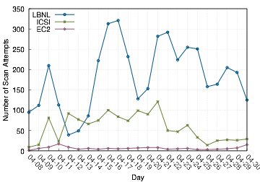
Attack Scene
We examined packet traces from Lawrence Berkeley National Laboratory (LBNL), the International Computer Science Institute (ICSI), and an Amazon EC2 honeypot
No evidence of attack prior to disclosure
We detected the first scan traffic 22 hours after disclosure from University of Latvia
In total, we observed 6,000 probe attempts from 692 hosts
Two major outliers—filippio.io (3,964 attempts from 40 hosts) and ssllabs.com (16 attempts from 5 hosts)
Notes:
In order to understand who was scanning for the vulnerability, we considered packet traces from LBNL, ICSI, and a honeypot on Amazon EC2.
We find no evidence of exploitation prior to public disclosure in any of the networks, but detect scans beginning within 22 hours.
In total, we observe nearly 6,000 probe attempts from ~700 hosts across all three networks.

Slide 43

Attack Scene
AS Name | Scans
Amazon.com | 4,267
China Telecom | 507
China169 Backbone | 147
Chinanet | 115
University of Michigan | 92
SoftLayer | 85
University of Latvia | 50
Rackspace | 47
GoDaddy.com | 34
Only 11 hosts scanned both EC2 honeypot and ICSI network
Only 6 hosts scanned more than 100 hosts at ICSI—Michigan, TU Berlin, Chinanet (2), Nagravision, and Rackspace
Appears to be little Internet-Wide scanning.
201 hosts scanned EC2 honeypot—attackers are likely targeting cloud providers’ address space
Notes:
However, only a handful of the hosts we observed appeared in more than one network. In total, we saw only 11 hosts that scanned both networks, of which only 6 scanned more than 100 hosts at ICSI. So while there was a large number of probe attempts, there appeared to be relatively low naïve Internet-wide scanning.
That being said, our honeypot on the Amazon EC2 network—which hosts no public services—received probes from over 200 distinct hosts, likely indicating that attackers are targeting this more dense address space.

Slide 44
Global Vulnerability Notifications
Two weeks post disclosure, nearly 600,000 hosts remained vulnerable
We contacted network administrators for non-embedded devices
We aggregated vulnerable hosts by WHOIS abuse contact (4,648 distinct contacts)
Split abuse contacts into two groups in order to measure the impact of large-scale notification
Notes:
As we discussed several slides back, there was little progress being made in patching IPv4 hosts and nearly 600K hosts remained vulnerable two weeks post disclosure.
We decided to notify the network operators responsible for these hosts. We aggregated vulnerable hosts by AS and sent notifications to 4,600 network operators with information on which hosts were vulnerable, how we detected vulnerable hosts, and how to patch the hosts.
We also used this as an opportunity to explore the effectiveness of large-scale vulnerability notifications. We split network operators into two groups, who we notified on two different dates.

Slide 45
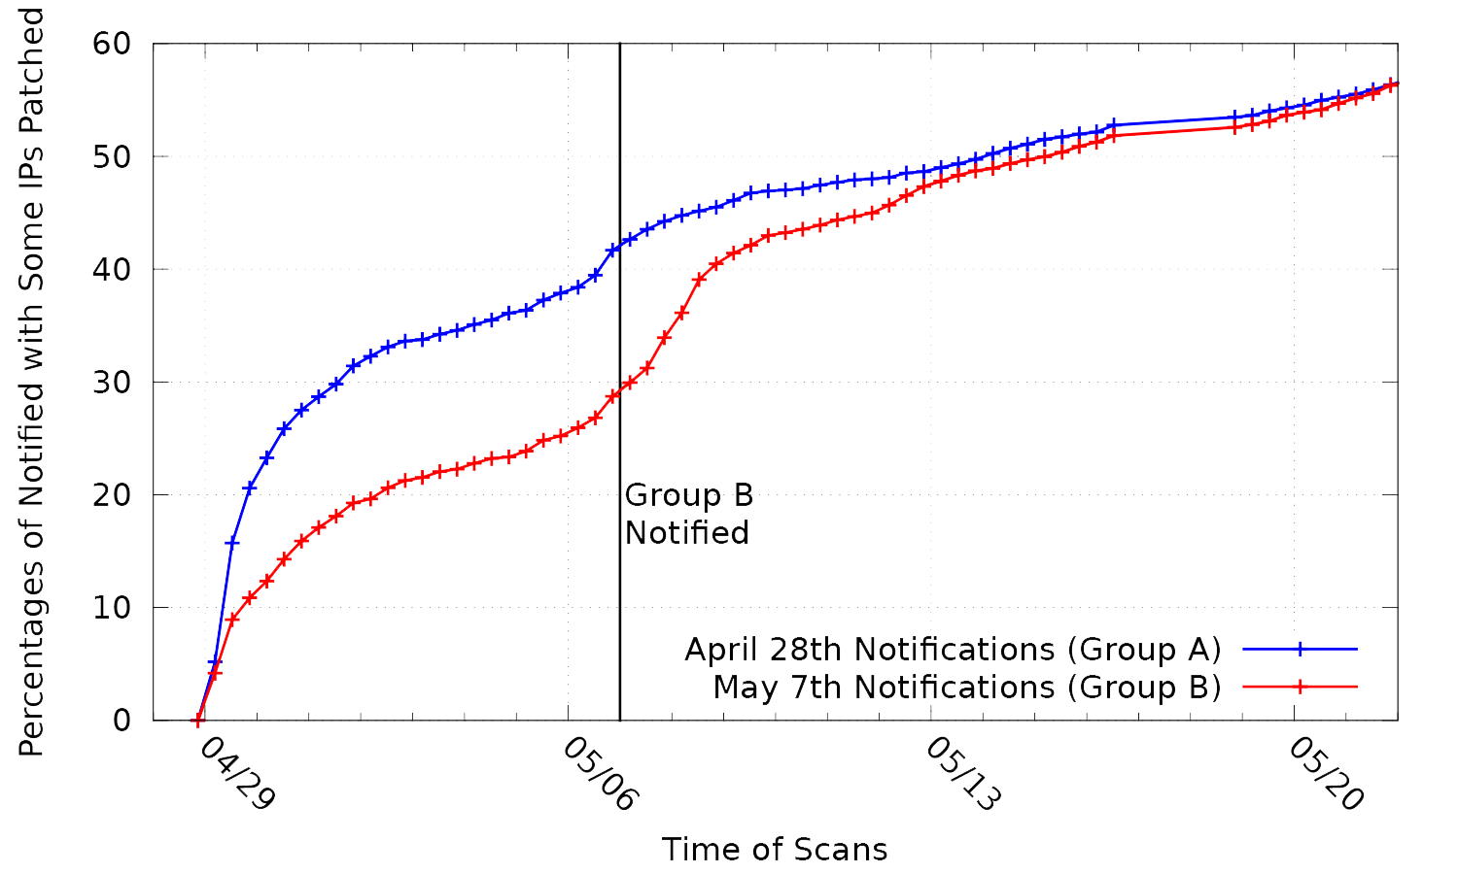
Impact on Patching
Notes:
And we find a surprising result — after a week when we began our second round of responsibilities, there was a 47% increase in patching in the operators that we did notify. Further, the responses we received were surprisingly positive—54/59 positive, 2 negative.

Slide 46
Impact on Patching
47% increase in patching
Notes:
And we find a surprising result — after a week when we began our second round of responsibilities, there was a 47% increase in patching in the operators that we did notify. Further, the responses we received were surprisingly positive—54/59 positive, 2 negative.

Slide 47
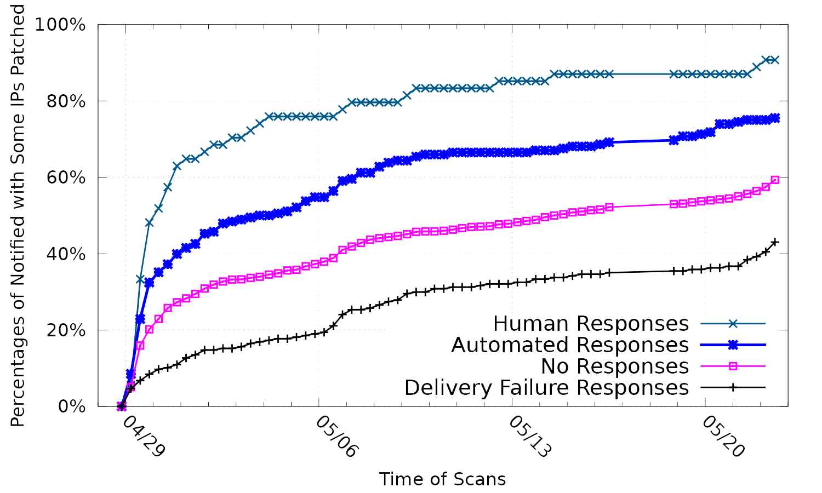
Notification Responses
Notes:
We also noted several distinct classes of operators when performing this notification.
A number of operators personally responded to us—which had the highest patching rate. However, we also noted a higher patch rate in the groups that sent us automated responses, or did not respond to notifications over the contacts for whom we received delivery failures.

Slide 48
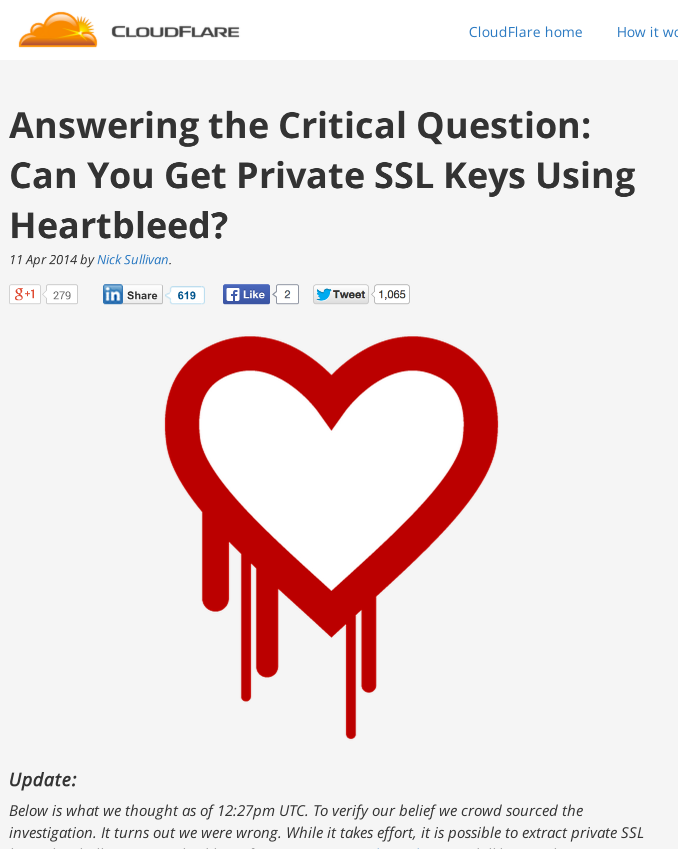
Cryptographic Keys at Risk
Patching isn’t enough—cryptographic keys can also be stolen
Proven during CloudFlare Challenge, in which keys were retrieved from generic nginx server
Security community recommended that administrators replace keys, revoke vulnerable certificates, and deploy perfect forward secrecy
Notes:
However, patching the vulnerability was likely not enough. As was shown in the CloudFlare challenge, private cryptographic keys could be retrieved from vulnerable servers
and the security community recommended that administrators replace and revoke their vulnerable certificates

Slide 49
Cryptographic Keys
We combined our Heartbleed scans with our daily scans of the HTTPS ecosystem and ICSI’s passive Certificate Notary in order to investigate certificate replacement
10.1% of the sites we found vulnerable replaced their certificates
14% re-used the vulnerable private key on new certificate
4% revoked their vulnerable certificates
Only 44% of connections use Perfect Forward Secrecy—Heartbleed did not spur further deployment
Notes:
Unfortunately administrators did not do as well. Only 10% of the sites we found vulnerable replaced their certificates and 4% revoked the vulnerable certificate.
Even more concerning, 14% of the sites that replaced their certificates reused the vulnerable key, indicating that administrators did not understand why they were replacing the certificate in the first place.
/ht the next guys. cite paper

Slide 50
Conclusion
Heartbleed took the Internet by surprise in April 2014
Internet-scale scanning allowed us to track who was vulnerable and understand what happened
For the most part, users did well at patching, but clearly not well enough to outpace attackers and hosts remain vulnerable today
We completed a large-scale notification effort in order to help spur patching — surprisingly positive result
Ultimately, we hope that this understanding will help us be better prepared the next time this happens

Slide 51
Questions?
Zakir Durumeric, Frank Li, James Kasten, Johanna Amann, Jethro Beekman, Mathias Payer, Nicolas Weaver, David Adrian, Vern Paxson, Michael Bailey, J. Alex Halderman
heartbleed@umich.edu

Slide 52
Neither Snow Nor Rain Nor MITM . . . An Empirical Analysis of Email Delivery Security
Zakir Durumeric† David Adrian† Ariana Mirian† James Kasten† Elie Bursztein‡ Nicolas Lidzborski‡ Kurt Thomas‡ Vijay Eranti‡ Michael Bailey§ J. Alex Halderman†
† University of Michigan
‡ Google, Inc.
§ University of Illinois, Urbana Champaign

Slide 53
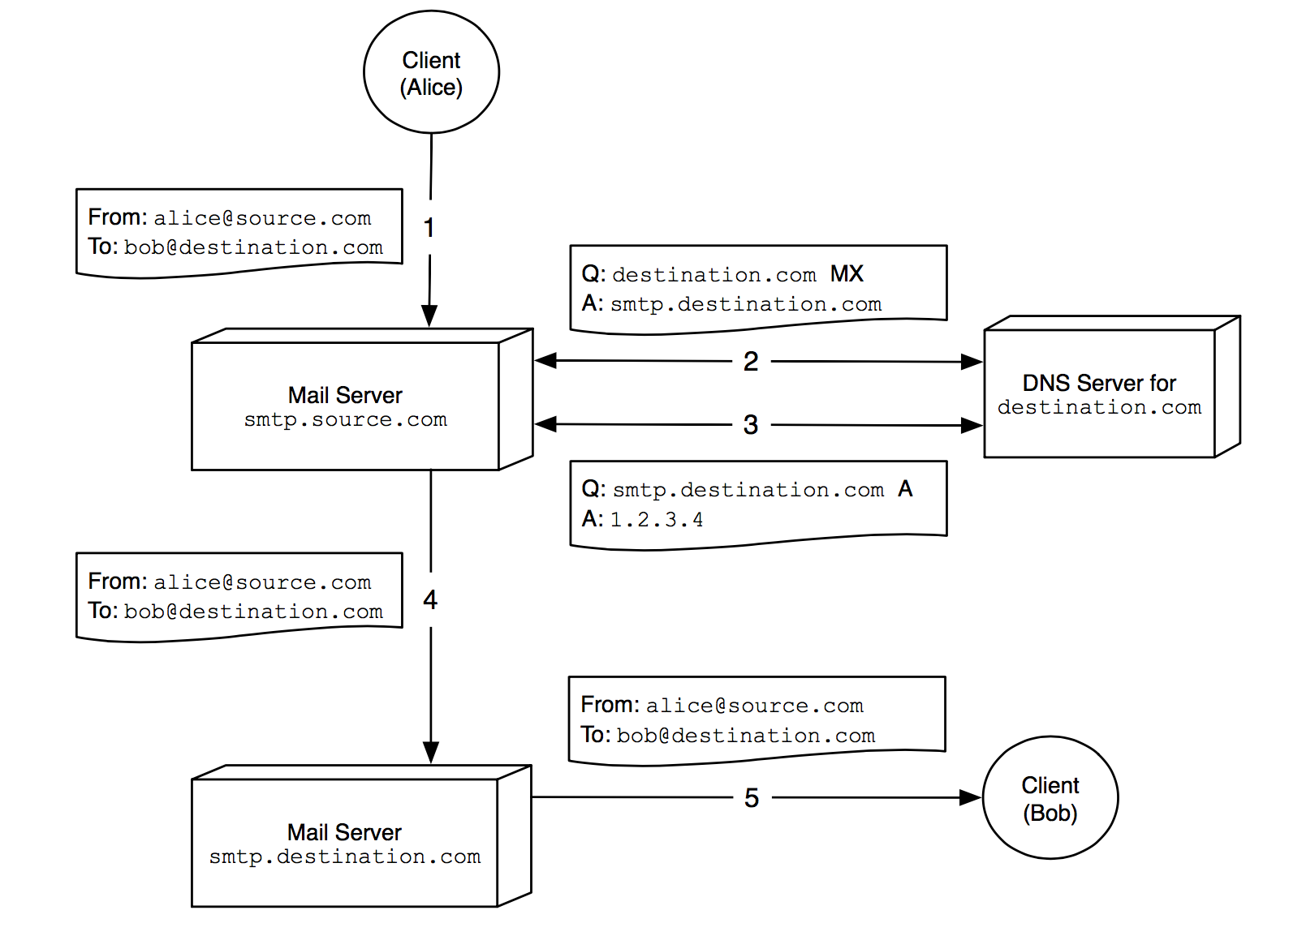
SMTP Protocol
Notes:
A client sends outgoing mail by con- necting to its organization’s local SMTP server (􏰀). The local server performs a DNS lookup for the mail exchange (MX) record of the destination.com domain, which contains the hostname of the desti- nation’s SMTP server, in this case smtp.destination.com (􏰁). The sender’s server then performs a second DNS lookup for the destina- tion server’s IP address (􏰂), establishes a connection, and relays the message (􏰃). The recipient can later retrieve the message using a secondary protocol such as POP3 or IMAP (􏰄).

Slide 54
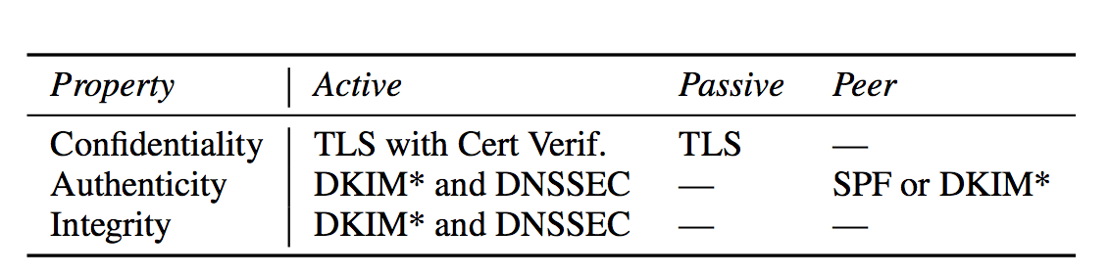
Security Properties
Notes:
Minimum protocol requirements for confidentiality, authenticity, and integrity against active, passive, and peer attackers. A “—” entry indicates an inapplicable com- bination. * note: while DKIM is theoretically sufficient, as used today, it is also neces- sary to advertise a strict policy using DMARC.

Slide 55
STARTTLS
S: <waits for connection on TCP port 25>
C: <opens connection>
S: 220 mail.example.org ESMTP service ready
C: EHLO client.example.org
S: 250-mail.example.org offers a warm hug of welcome
S: 250 STARTTLS
C: STARTTLS
S: 220 Go ahead
C: <starts TLS negotiation>
C & S: <negotiate a TLS session>
C & S: <check result of negotiation>
C: EHLO client.example.org[3]
. . .

Slide 56
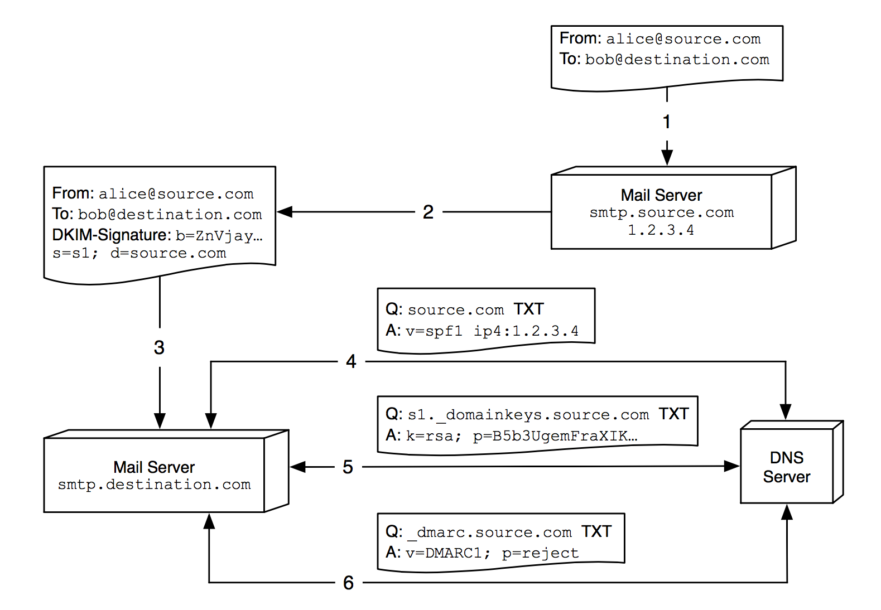
Mail Authentication
Notes:
SPF, DKIM, and DMARC are used to provide source authentication. The outgoing server digitally signs the message (􏰁). The receiving mail server performs an SPF lookup (􏰃) to check if the outgoing server is whitelisted, a DKIM lookup (􏰄) to determine the public key used in the signature, and a DMARC lookup (􏰅) to determine the correct action should SPF or DKIM validation fail.

Slide 57
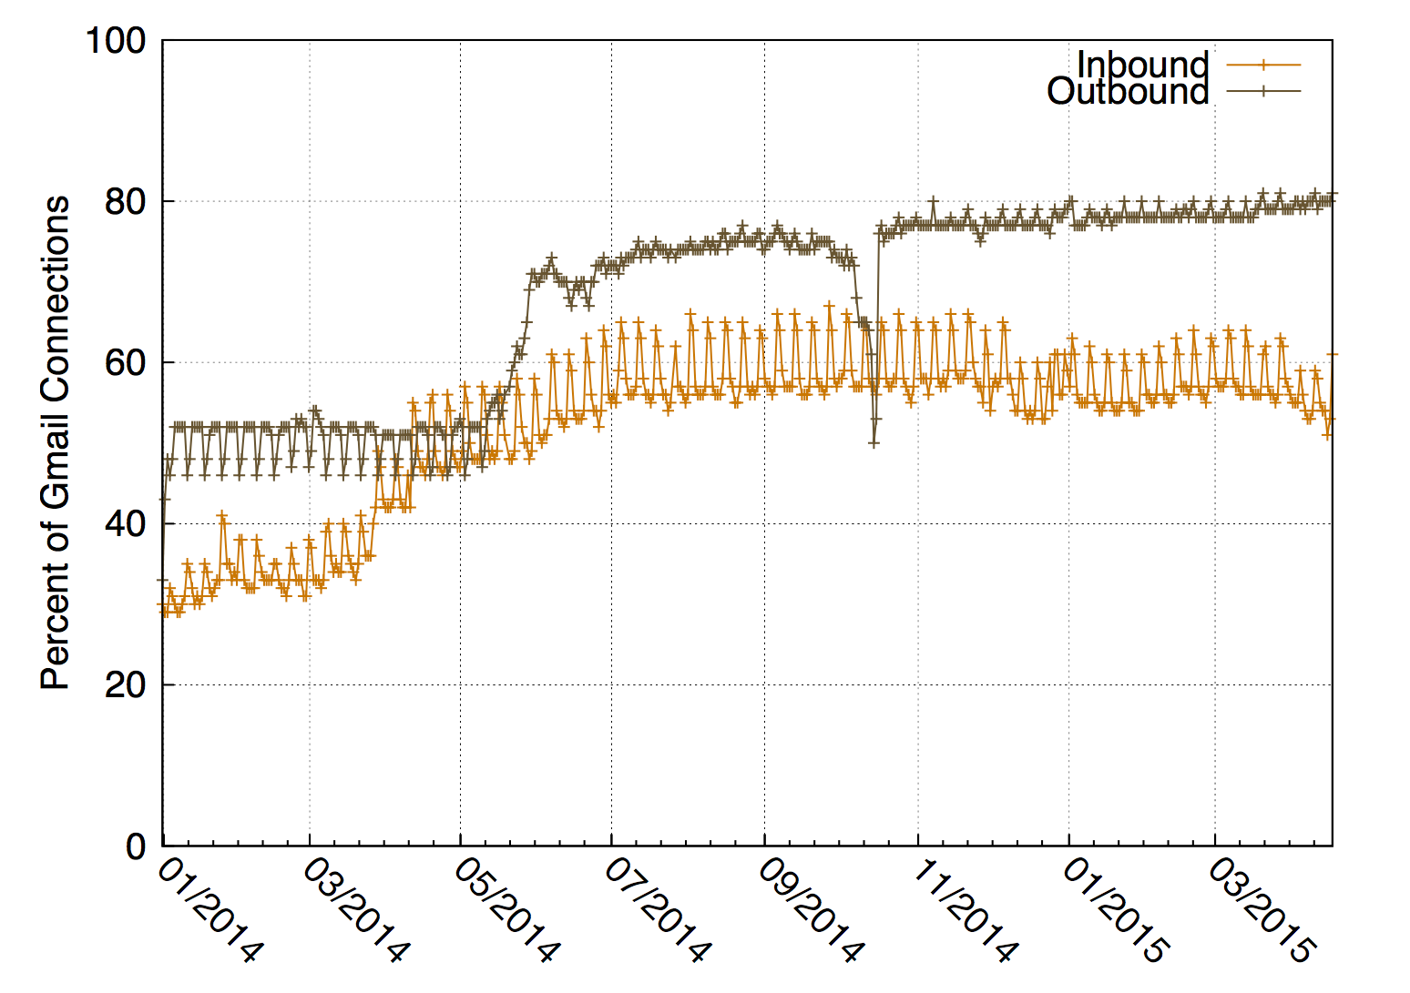
Historical Gmail STARTTLS Support

Slide 58
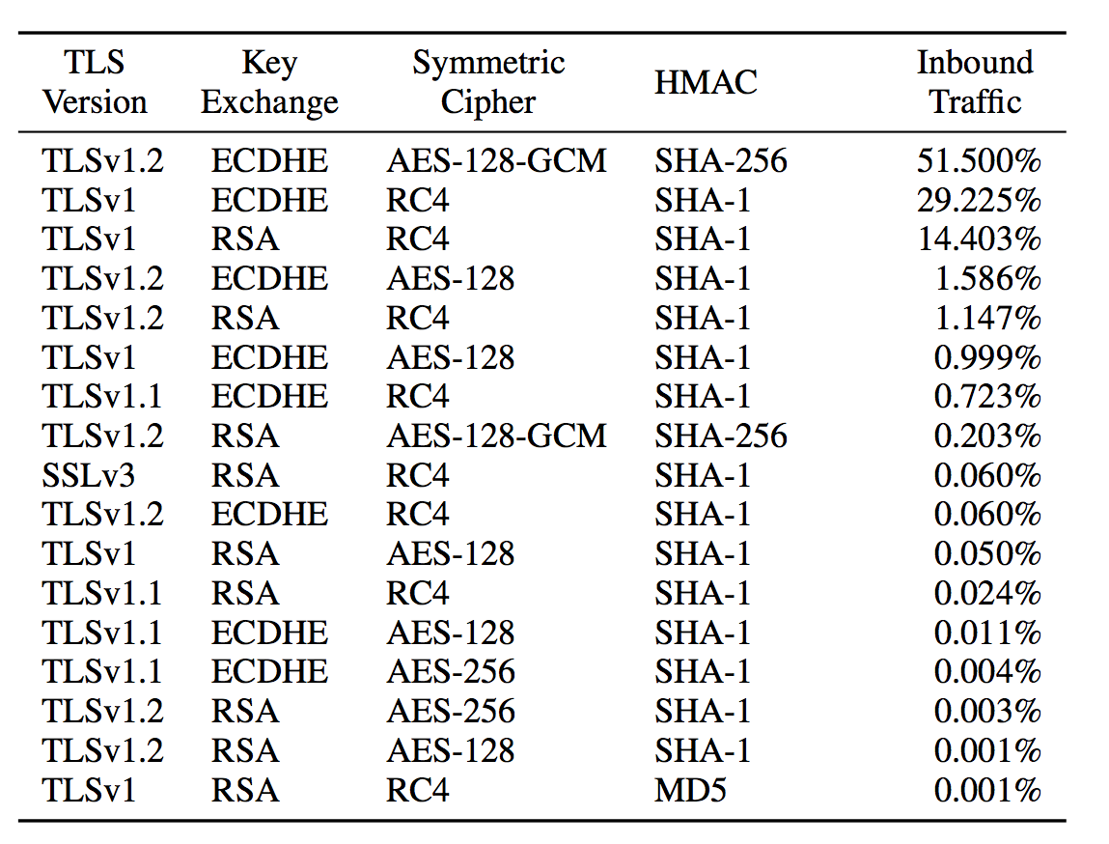
Cipher Suites for Inbound Gmail Traffic
Notes:
80% of in-bound Gmail connections are protected by TLS. Here, we present the selected cipher suites for April 30, 2015.

Slide 59
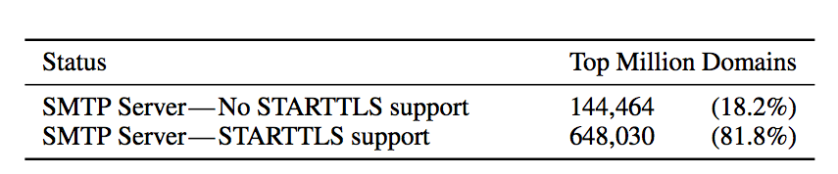
STARTTLS Deployment by Top Million Domains
Notes:
our scan results show that 79% of Alex Top Million domains have incoming SMTP servers, of which 81.8% support STARTTLS.

Slide 60
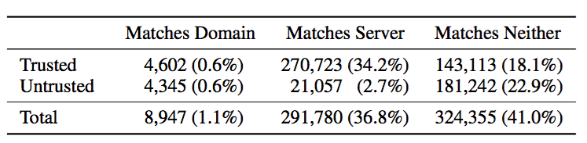
Certificates for Top Million Domains
Notes:
Certificates for Top Million Domains—While 52% of domains’ SMTP servers present trusted certificates, only 34.2% of trusted certificates match the MX server, and only 0.6% are valid for the recipient domain.

Slide 61
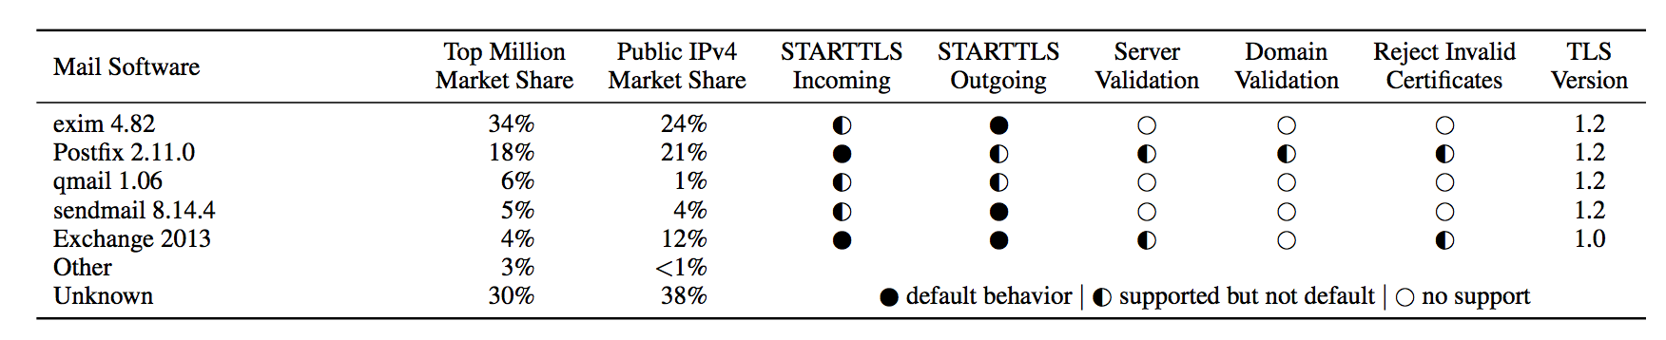
Popular Mail Transfer Agents (MTA)

Slide 62
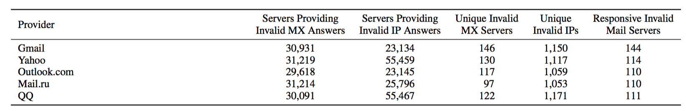
Fraudulent DNS Responses
Notes:
We scanned the public IPv4 address space for DNS servers that returned falsified MX records or SMTP server IP addresses for five popular mail providers. This data excludes loopback addresses and obvious configuration errors.

Slide 63
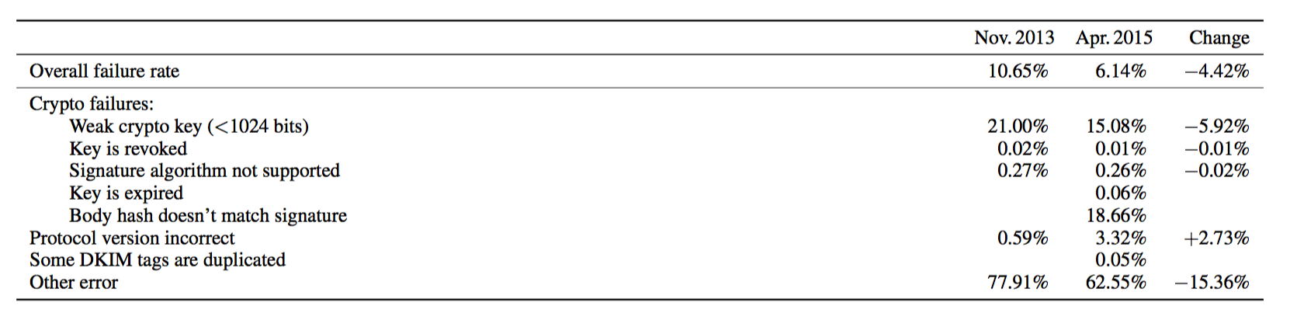
Gmail DKIM Errors
Notes:
We present the breakdown of Gmail DKIM validation failures for November 2013 and April 2015.

Slide 64
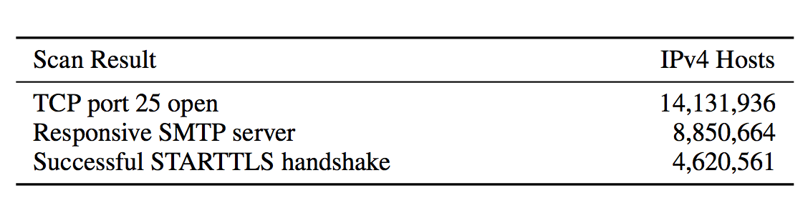
IPv4 SMTP Scan Results
Notes:
We could perform a START- TLS handshake with 52% of the SMTP servers that our IPv4 scans identified.

Slide 65
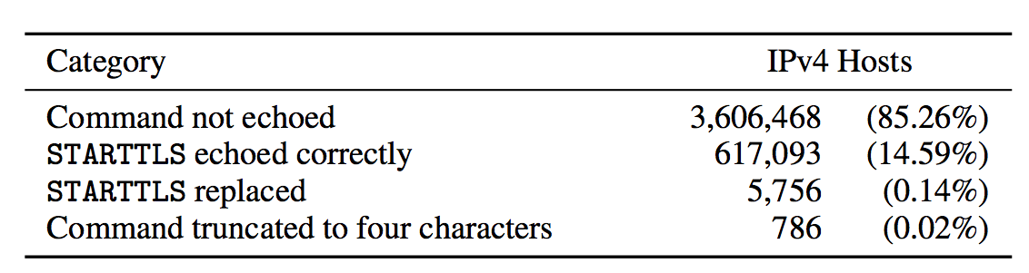
Detecting STARTTLS Manipulation
Notes:
We could ex- tract an echoed command from 14.75% of servers that sent errors in response to our STARTTLS command. 0.14% of these responses indi- cate that the command was tampered with before reaching the server.

Slide 66
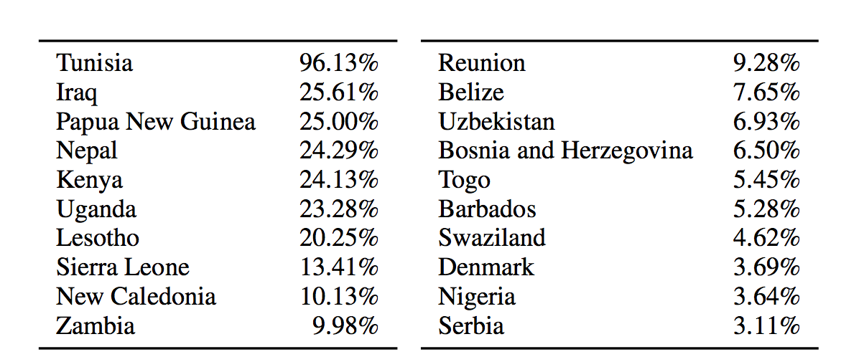
Countries Affected by STRATTLS Stripping
Notes:
We measure the fraction of incoming Gmail messages that originate from the IPs that we found were stripping TLS from SMTP connec- tions. Here, we show the countries with the most mail affected by STARTTLS stripping and the affected percentage of each country’s incoming mail between April 20 and 27, 2015.

